Slide 1
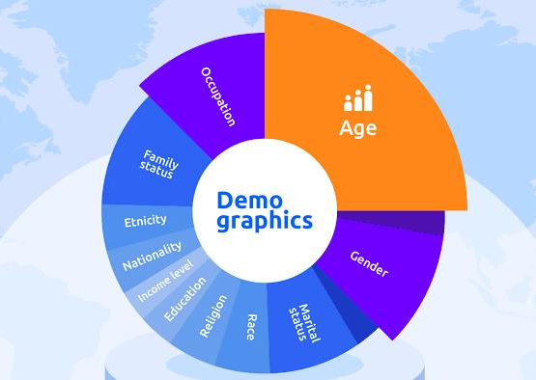
Demographic Factors Influencing Income
Group -6
Vaishnavi Wadhwa – 8939083
Nayan Raut – 8939875
Kavya Priya – 8915191
Mohamed Sultan - 8950038

Slide 2

Agenda
Introduction
Analysis Approach
Key Insights
Recommendations
Appendix

Slide 3

Introduction
Demographic factors such as age, occupation, work hours, and marital status significantly influence income levels. Understanding these factors helps in identifying patterns and disparities among different groups. This analysis examines how various demographic factors relate to income, providing insights into how these factors contribute to economic outcomes.

Slide 4
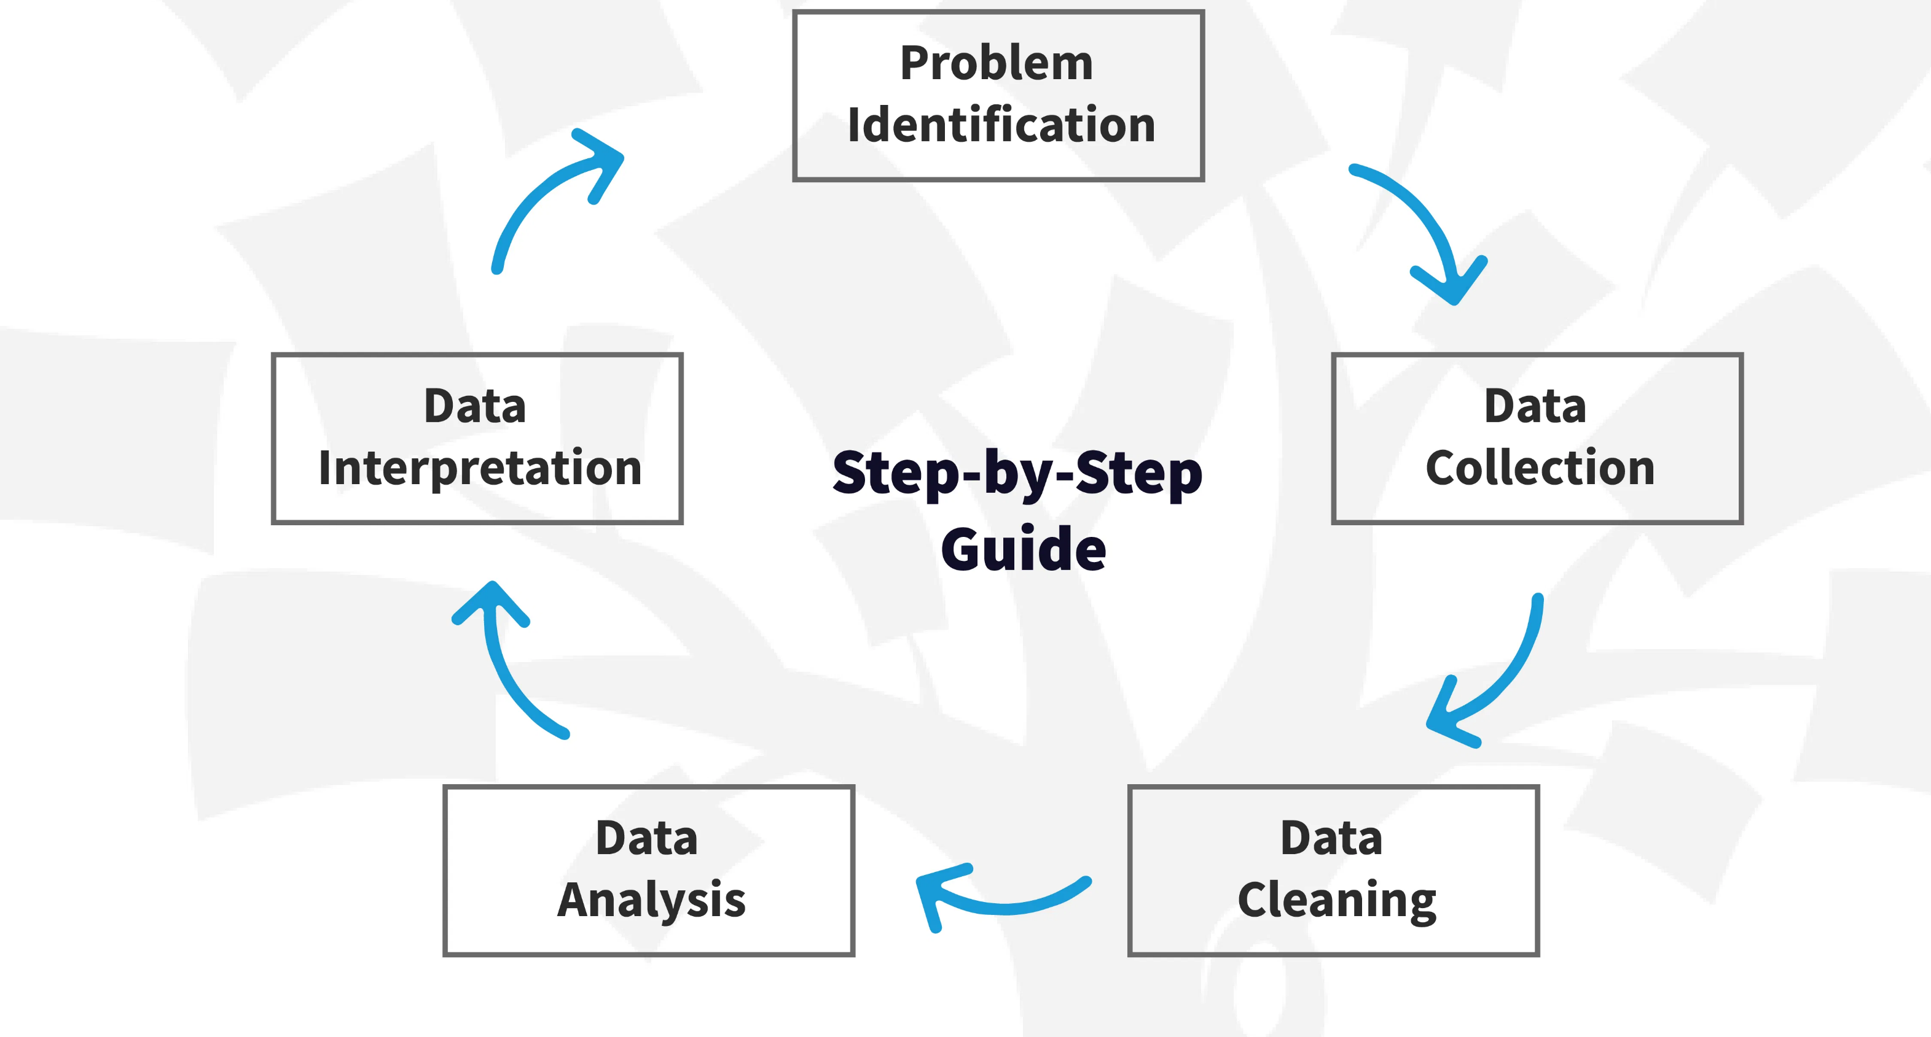
Analysis Approach

Slide 5
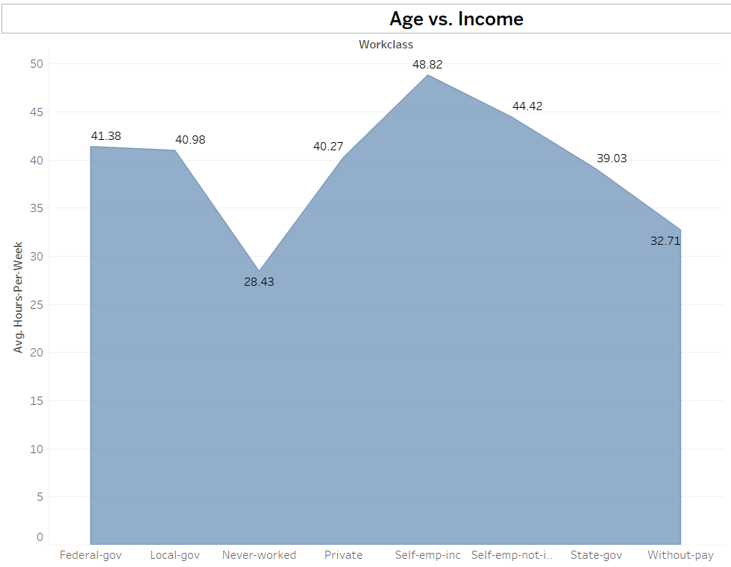
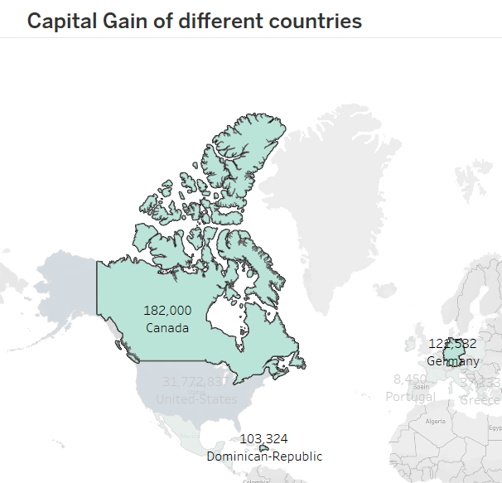
Key Insights
Age vs. Income: - These results depict that the employees working with the federal government have the highest average weekly hours worked, 48. 82, compared to other classes of workers.
Capital Gain by Country: - Germany is the third country in terms of capital gain among the countries under analysis; the leader is Canada, followed by the Dominican Republic.

Slide 6
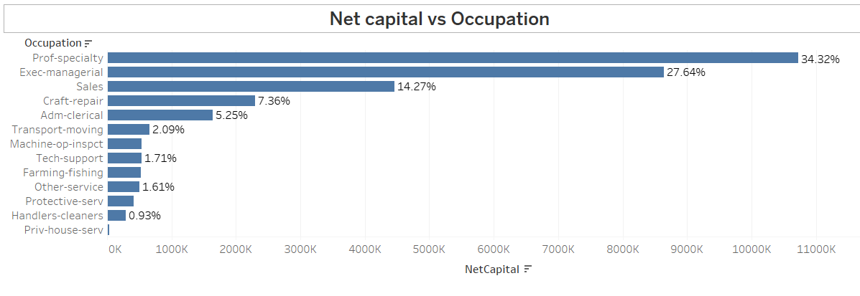
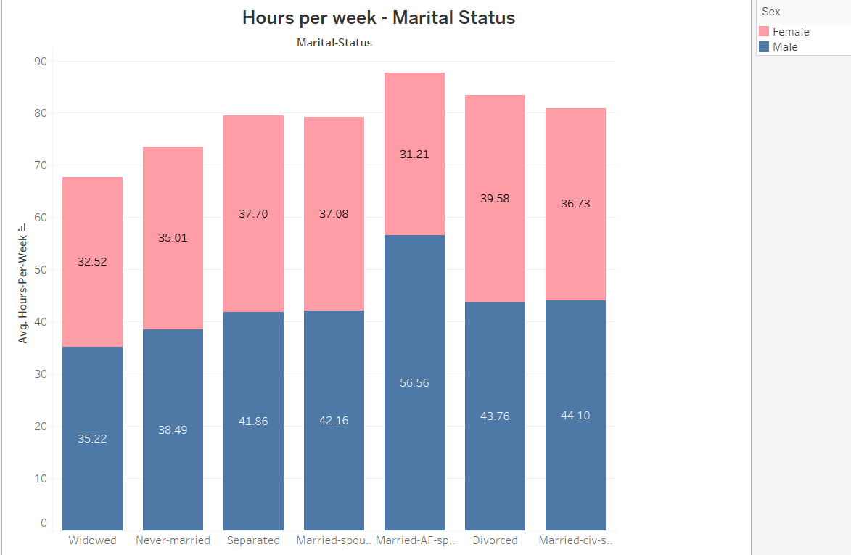
Key Insights
Net Capital vs. Occupation: Professional specialties provide the overall highest net capital gain with an average of 34. 32% of the total amount allotted while those in the executive managerial positions are next.
Hours Per Week vs Marital Status: Married males work the most hours per week on average (56.56 hours), while never-married individuals work the least.

Slide 7
Recommendations
Short-Term
Long-Term
Targeted Training
Work-life Balance
Economic Policies
Equal Rewards

Slide 8
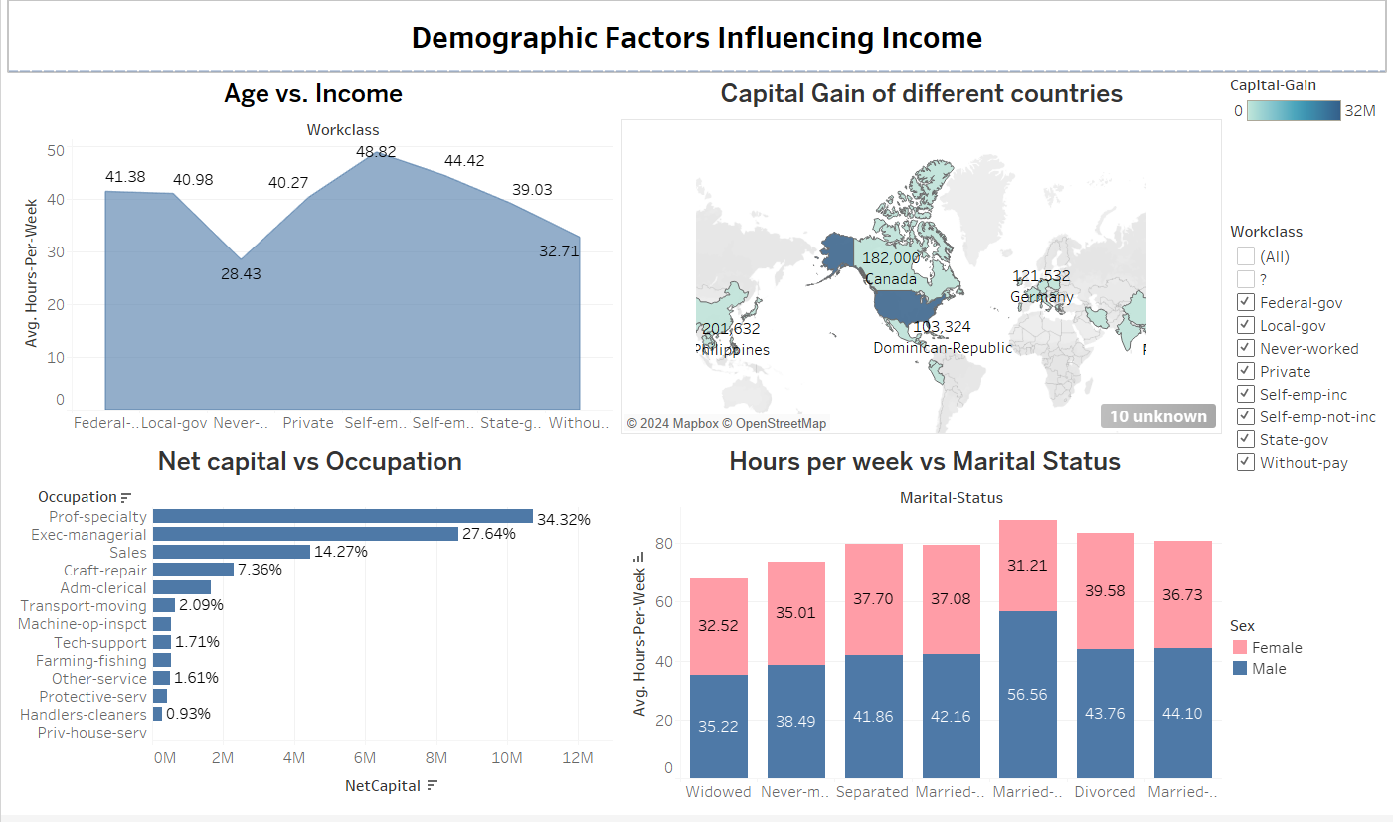
Appendix

Slide 9
Resource Allocation
Task Assigned | Resource | Start Date | End Date | Status
Problem Selection | Sultan | 08/01/2024 | 08/03/2024 | Done
Data Cleaning | Vash | 08/03/2024 | 08/04/2024 | Done
Understanding Data | Everyone | 04/08/2024 | 05/08/2024 | Done
Age vs Income | Sultan | 06/08/2024 | 06/08/2024 | Done
Capital gain of different countries | Nayan | 06/08/2024 | 06/08/2024 | Done
Net Capital vs Occupation | Kavya | 06/08/2024 | 06/08/2024 | Done
Hours per week vs Marital Status | Vash | 06/08/2024 | 06/08/2024 | Done
Key Insights | Everyone | 07/08/2024 | 07/08/2024 | Done
Dashboard Creation | Everyone | 08/08/2024 | 08/08/2024 | Done
Recommendations | Everyone | 08/08/2024 | 08/08/2024 | Done
Presentation Creation | Everyone | 08/08/2024 | 08/08/2024 | Done
Report Creation | Everyone | 08/08/2024 | 08/08/2024 | Done

Slide 10
References
Kaggle. (2022). Income Evaluation. Dataset https://www.kaggle.com/datasets/vijayadityads/income-evaluation

Slide 11


